Slide 1

CHAPTER SIX
GRAPHICS AND MULTIMEDIA
By: Behayilu M.
Faculty of Computing and Software Engineering(FCSE),
Arba Minch Institute of Technology(AMiT),
Arba Minch University

Slide 2
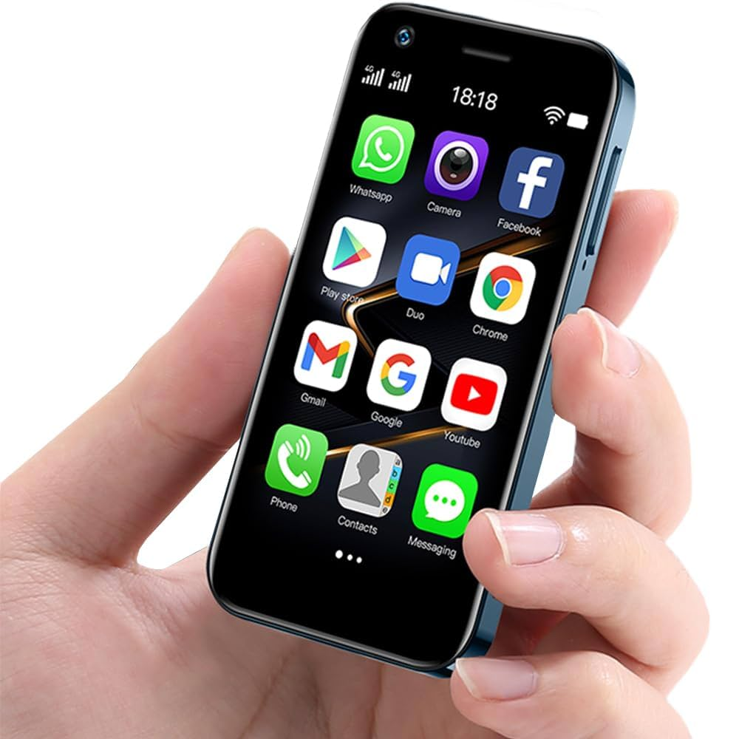
CONTENTS
Android Graphics
Material design
Layout inflation
AdapterView
Android Multimedia
Frameworks and Libraries

Slide 3
Android Graphics - introduction
Android graphics refers to the system and APIs Android provides to draw, render, and display visual content on the screen—such as shapes, text, images, animations, and videos.
In simple terms: anything you see on an Android screen is produced using Android graphics.
Android graphics are used to:
  Design UI components (buttons, text, images)
  Draw custom views (charts, games, signatures)
  Show images and videos
  Create animations
  Build 2D and 3D games
Android provides a rich set of UI components for building visually appealing interfaces.

Slide 4
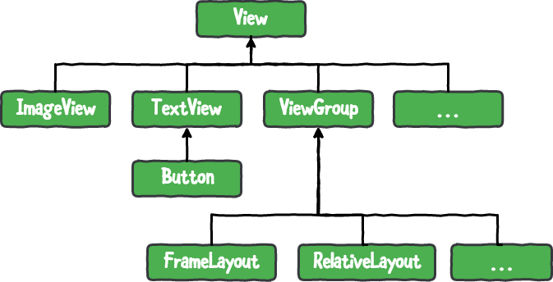
…cont’d
The following play significant role in UI design:
  Views
  ViewGroups
  Xml layouts
  Styling and Themes
  Icons and Images
  Typography and Fonts
  Material Design

Slide 5
Using Material Design
Material Design in Android is Google’s official design system used to build modern, clean, and consistent user interfaces across Android apps (and even web apps).
It defines how apps should look and behave.
Material Design is a design language created by Google that provides:
  Visual guidelines
  UI components
  Motion & animation rules
  Best practices for layout, colors, typography
It helps developers create apps that are beautiful, consistent, and user-friendly.
View → TextView → Button → MaterialButton

Slide 6
How to Use Material Design
Step 1: Add to build.gradle (Add the dependency)
// In your app/build.gradle file(Module:app)
dependencies {
implementation 'com.google.android.material:material:1.13.0’ // use the latest
}
Step 2: Use Material Components in XML
<!-- Instead of regular Button -->
<Button
android:text="Old Button" />
<!-- Use MaterialButton -->
<com.google.android.material.button.MaterialButton
android:text="Nice Material Button" />
Just use built-in Roboto (already in Android)
Material Design recommends using the Roboto font family for Android apps
<com.google.android.material.button.MaterialButton
android:id="@+id/buttonOne"
android:layout_width="wrap_content"
android:layout_height="wrap_content"
android:text=“Click me"
android:textColor="@android:color/red"
app:cornerRadius="8dp“
android:fontFamily="sans-serif"/>

Slide 7
How to Use Material Design
Step 3: Enjoy the Benefits!
import com.google.android.material.button.MaterialButton;
public class MainActivity extends AppCompatActivity
{
protected void onCreate(Bundle savedInstanceState) {
super.onCreate(savedInstanceState);
setContentView(R.layout.activity_main);
MaterialButton buttonOne = findViewById(R.id. buttonOne); // Button button = findViewById(R.id.redButton);
buttonOne.setOnClickListener(new View.OnClickListener() {
@Override
public void onClick(View v) {
Toast.makeText(MainActivity.this, "Button Clicked!", Toast.LENGTH_SHORT).show();
}
});
}
}

Slide 8
Parent theme
In Android, a parent theme is essentially a predefined theme from which your app or activity theme inherits properties.
It acts like a base template for your UI styles, such as colors, text appearances, and widget styles.
By using a parent theme, you don’t have to define every attribute yourself; your theme automatically gets the attributes defined in the parent.
Material Theme is a ready-made parent theme created by Google.
A parent theme is specified in your values folder themes.xml or styles.xml file using the parent attribute:

Slide 9
…cont’d
<style name="AppTheme" parent="Theme.MaterialComponents.DayNight.DarkActionBar">
<!-- Customizations go here -->
<item name="colorPrimary">@color/purple_500</item>
<item name="colorPrimaryVariant">@color/purple_700</item>
<item name="colorAccent">@color/teal_200</item>
</style>
AppTheme → Your custom theme.
Theme.MaterialComponents.DayNight.DarkActionBar → The parent theme your theme inherits from.
Types of Parent Themes
Built-in Android themes: e.g., Theme.Holo, Theme.Material, Theme.Material.Light.
Material Components themes: e.g., Theme.MaterialComponents.DayNight, Theme.MaterialComponents.Light.NoActionBar.
Custom themes: You can create a theme that itself is a parent for another theme.

Slide 10
Layout Inflation
In Android, inflation is the process of converting an XML layout file into actual View objects in memory that can be displayed and interacted with in your app.
Think of XML layouts as a blueprint. Inflation is the step where Android reads the blueprint and builds the actual UI components at runtime.
Without inflating, the XML is just static data—it doesn’t exist as real views that the user can see or interact with.
In short: Inflation = XML layout → real UI views that your app can display.
Common uses
Adding custom rows to a LinearLayout
Creating items for RecyclerView or ListView

Slide 11
How it works
Define your XML layout
Inflate the layout in activity or fragment using LayoutInflator class
Call the inflate() method on the LayoutInflator passing the resource ID of xml layout file, a parent view(optional) and a Boolean flag indicating immediate attachment to the parent
Access the views using their id
Using the inflated layout as per your need
<LinearLayout xmlns:android="http://schemas.android.com/apk/res/android"
android:id="@+id/container"
android:orientation="vertical"
android:layout_width="match_parent"
android:layout_height="match_parent">
</LinearLayout>

Slide 12
…cont’d
public class MainActivity extends AppCompatActivity {
LinearLayout container;
protected void onCreate(Bundle savedInstanceState) {
super.onCreate(savedInstanceState);
setContentView(R.layout.activity_main);
container = findViewById(R.id.container);
LayoutInflater inflater = getLayoutInflater();
String[] items = {"Apple", "Banana", "Cherry"};
for (String item : items) {
// Inflate a TextView directly without XML template
TextView tv = (TextView) inflater.inflate(android.R.layout.simple_list_item_1, container, false);
tv.setText(item);
container.addView(tv);
}
}
}
Apple
Banana
Cherry

Slide 13
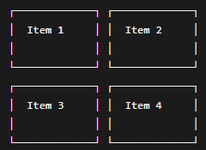
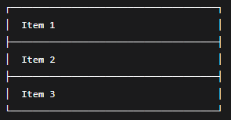

Adapter View
AdapterView is a special type of view in Android that displays a list or collection of items by connecting (adapting) data to UI elements.
AdapterView = View that shows many items using an Adapter.
It does NOT store or create the views by itself — instead, it asks an Adapter to provide views for each data item.
Adapter Views are views such as Spinner, ListView, GridView etc.
They are used for dynamic content or not pre-defined layout or content

Slide 14
Adapter View
Examples of AdapterView
public class AdapterView<T extends Adapter> extends ViewGroup
Why Adapter??
Because AdapterView uses an Adapter such as: ArrayAdapter, CursorAdapter, SimpleAdapter, BaseAdapter
The Adapter converts data → View.
Your Data → Adapter → AdapterView (ListView, GridView etc.)
AdapterView | Description
ListView | Shows items in a vertical list
GridView | Shows items in a grid layout
Spinner | Shows dropdown list
ExpandableListView | Shows hierarchical lists

Slide 15
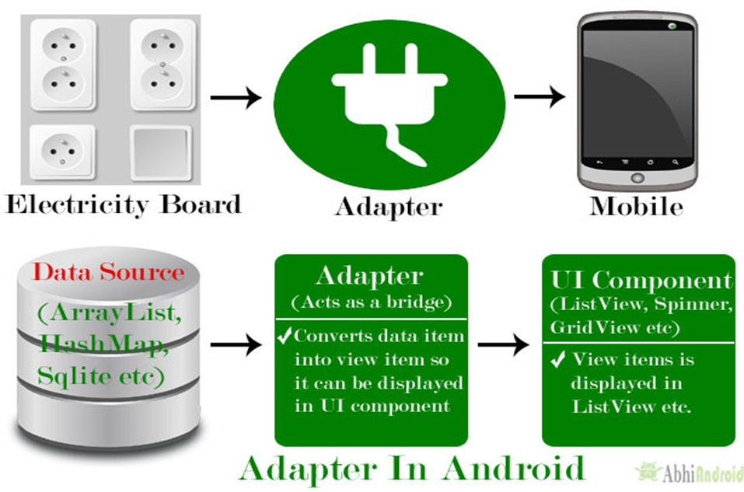
…cont’d

Slide 16
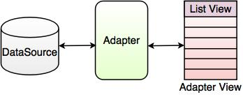
Adding Data to Adapter view
We bind adapter view instance to an adapter which retrieves data from an external source and create a view that represents each data entry.
The most common adapter types:
ArrayAdapter:-Display an array or list of simple items (like strings) in a ListView or Spinner.
SimpleCursorAdapter:- Display data from a SQLite database using a Cursor. (Deprecated)
RecyclerView.Adapter : -Used with RecyclerView for modern, flexible, high-performance lists.

Slide 17
ArrayAdapter
ArrayAdapter is one of the simplest and most commonly used adapters in Android.
ArrayAdapter is a bridge that takes your data (Array/List) and puts it into views (like ListView).
It converts each item in an array into a view (a row).
It helps you connect a Java List/Array to a UI component like:
    ListView
    Spinner
    AutoCompleteTextView
Why do we need ArrayAdapter?
UI components (ListView, Spinner…) cannot display a list by themselves.

Slide 18
Example 1: Basic ArrayAdapter with ListView
android.R.layout.simple_list_item_1 → built-in layout for each row.
ListView listView = findViewById(R.id.listView);
String[] names = {"John", "Mary", "Alex", "Sara"};
ArrayAdapter<String> adapter =new ArrayAdapter<>(this, android.R.layout.simple_list_item_1, names);
listView.setAdapter(adapter);
<ListView
android:id="@+id/listView"
android:layout_width="match_parent"
android:layout_height="match_parent"/>

Slide 19
Example 2: ArrayAdapter with Spinner(DropDown Menus)
When to use ArrayAdapter?
Only one TextView → use ArrayAdapter
Image + Text → use Custom Adapter (BaseAdapter / RecyclerView)
Multiple views → use Custom Layout
Spinner spinner = findViewById(R.id. mySpinner);
String[] colors = {"Red", "Green", "Blue"};
ArrayAdapter<String> adapter = new ArrayAdapter<>(this,
android.R.layout.simple_spinner_item, colors);
adapter.setDropDownViewResource(android.R.layout.simple_spinner_dropdown_item);
spinner.setAdapter(adapter);
<Spinner
android:id="@+id/mySpinner"
android:layout_width="wrap_content" android:layout_height="wrap_content"/>

Slide 20
SimpleCursorAdapter
  SimpleCursorAdapter is an adapter in Android that maps data from a Cursor (usually from a database) to views in a ListView or other AdapterView.
  It's part of the android.widget package and is particularly useful for displaying data from SQLite databases in list format.
  Key Characteristics
  Cursor-based: Works with Cursor objects returned from database queries
  Simple mapping: Maps columns from Cursor to TextViews or ImageViews
  Deprecated: As of API 11, it's deprecated in favor of CursorAdapter and modern alternatives.

Slide 21
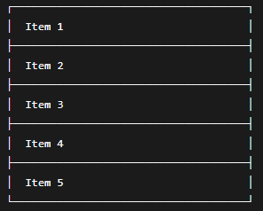
RecyclerViewAdapter
In Android, RecyclerView.Adapter (often written as RecyclerViewAdapter) is a class that controls how data is displayed inside a RecyclerView.
RecyclerView.Adapter is a class that:
  Creates item views (rows, cards, list items)
  Fills those item views with your data
  Tells RecyclerView how many items you have
Without an Adapter, RecyclerView cannot show anything.
Think of it as the bridge between your data and the RecyclerView UI.
Think of RecyclerView as ListView 2.0 (Improved Version).

Slide 22
public class MainActivity extends AppCompatActivity {
RecyclerView recyclerView;
protected void onCreate(Bundle savedInstanceState) {
super.onCreate(savedInstanceState);
setContentView(R.layout.activity_main);
recyclerView = findViewById(R.id.recyclerView);
recyclerView.setLayoutManager(new LinearLayoutManager(this));
List<String> data = Arrays.asList("Apple", "Banana", "Orange", "Mango");
// Set adapter
MyAdapter adapter = new MyAdapter(data);
recyclerView.setAdapter(adapter);
}
}
<androidx.recyclerview.widget.RecyclerView
android:id="@+id/recyclerView"
android:layout_width="match_parent"
android:layout_height="match_parent" />

Slide 23
public class MyAdapter extends RecyclerView.Adapter<MyAdapter.MyViewHolder> {
List<String> list;
public MyAdapter(List<String> list) {
this.list = list;
}
@NonNull
public MyViewHolder onCreateViewHolder(@NonNull ViewGroup parent, int viewType) {
View view = LayoutInflater.from(parent.getContext()).inflate(android.R.layout.simple_list_item_1, parent, false);
return new MyViewHolder(view);
}
public void onBindViewHolder(@NonNull MyViewHolder holder, int position) {
holder.textView.setText(list.get(position));
}
public int getItemCount() {
return list.size();
}
static class MyViewHolder extends RecyclerView.ViewHolder {
TextView textView;
public MyViewHolder(@NonNull View itemView) {
super(itemView);
textView = itemView.findViewById(android.R.id.text1);
}
}
}
MyAdapter.java
ViewHolder = Pizza Box Analogy:
Make 8 pizza boxes (onCreateViewHolder)
Put pizza in box 1 (onBindViewHolder - position 0)
Put pizza in box 2 (onBindViewHolder - position 1)
Deliver pizzas (show on screen)
Empty box returns (scrolls off screen)
Reuse box for new pizza (recycling!)

Slide 24
Simple Explanation
1. The 3 Main Parts:
public class MyAdapter { // 1. Manager class
List<String> list; // 2. Your data (like: ["Apple", "Banana"])
static class MyViewHolder { // 3. Reusable container
TextView textView; // Holds ONE item's views
}
}
2. The 3 Key Methods:
onCreateViewHolder()
// Makes ONE empty list item template
// Example: Creates this:
B. onBindViewHolder()
// Puts data into the template
// Example: Takes "Apple" → puts in template
// Result:
C. getItemCount()
// Says how many items total
// Example: Returns 2 (for ["Apple", "Banana"])
3. What Happens:
Step 1: RecyclerView asks "How many items?"
→ Adapter says "2 items"
Step 2: RecyclerView says "Make 2 templates"
→ Adapter creates 2 empty boxes
Step 3: RecyclerView says "Fill box 1 with data 1"
→ Box 1 shows "Apple"
Step 4: RecyclerView says "Fill box 2 with data 2"
→ Box 2 shows "Banana"
Screen shows: [Apple]
[Banana]
Step 5: When you scroll, boxes get reused!
Apple

Slide 25
Multimedia in Android
Android provides a range of multimedia capabilities for audio, video, and image handling.
Most of the media interaction is done by Media Player API, for
  Playing audio
  Playing video

Slide 26
Images in Android
Android provides various tools and components for working with images.
ImageView is component for displaying images in Android.
Image resource can be set from local resource or remote URLs.

Slide 27
Setting Image Source from Local Resources
Place the image file in the appropriate resource directory (e.g. res/drawable).
In your XML layout file, locate the ImageView component where you want to display the image.
Use the android:src attribute to set the image source
  <ImageView
  android:id="@+id/imageView"
  android:layout_width="wrap_content"
  android:layout_height="wrap_content"
  android:src="@drawable/my_image" />

Slide 28
Setting Image Source from Remote URLs
Ensure you have the necessary permissions (e.g. INTERNET permission) in your AndroidManifest.xml file to access the internet.
In your Java code, obtain a reference to the ImageView component:
ImageView imageView = findViewById(R.id.imageView);
Use an image loading library like Picasso, Glide, or Fresco to handle remote image loading and caching.
With the chosen library, load the image from the remote URL into the ImageView.

Slide 29
…cont’d
For example, using Picasso:
String imageUrl = "https://www.example.com/my_image.jpg";
Picasso.get().load(imageUrl).into(imageView);
For example, using Glide:
String imageUrl = "https://www.example.com/my_image.jpg";
Glide.with(this).load(imageUrl).into(imageView)

Slide 30
Using Glide (Recommended)
1. Add Internet Permission in AndroidManifest.xml
<uses-permission android:name="android.permission.INTERNET" />
<application
... >
2. Add Glide Dependency (build.gradle)
Open app/build.gradle and add:
dependencies {
implementation 'com.github.bumptech.glide:glide:4.16.0'
annotationProcessor 'com.github.bumptech.glide:compiler:4.16.0'
}

Slide 31
Using Glide (Recommended)
<?xml version="1.0" encoding="utf-8"?>
<LinearLayout xmlns:android="http://schemas.android.com/apk/res/android"
android:layout_width="match_parent"
android:layout_height="match_parent"
android:gravity="center"
android:orientation="vertical"
android:padding="16dp">
<ImageView
android:id="@+id/imageView"
android:layout_width="250dp"
android:layout_height="250dp"
android:scaleType="centerCrop"
android:background="#CCCCCC" />
</LinearLayout>
public class MainActivity extends AppCompatActivity {
ImageView imageView;
protected void onCreate(Bundle savedInstanceState) {
super.onCreate(savedInstanceState);
setContentView(R.layout.activity_main);
imageView = findViewById(R.id.imageView);
String imageUrl = "https://picsum.photos/400"; // Sample online image
Glide.with(this)
.load(imageUrl)
.placeholder(R.drawable.ic_launcher_background) // Shown while loading
.error(R.drawable.ic_launcher_foreground) // Shown if loading fails
.into(imageView);
}
}

Slide 32
Image Loading and Caching Libraries
Android provides different kinds of image loading and caching libraries
 | GLIDE | PICASSO | FRESCO
Owner | Bumptech | Square Inc | Facebook
Ease of use | Simple | Simple | Not good
Disk and Memory cache | High | Yes | Yes
View used | ImageView | ImageView | SimpleDraweeView
GIF support | Yes | No | Yes
Library size | Big | Small | Big

Slide 33
Audio PlayBack
Audio playback in Android is the process of playing sound files or streams through your phone or tablet's speakers, headphones, or connected devices.
Audio playback in Android can be achieved using various components and APIs provided by the Android framework.
Android supports various audio formats and codecs, such as MP3, AAC, FLAC, and Ogg Vorbis.
The key components and steps involved in implementing audio playback:

Slide 34
Media Player (steps )
Create an instance of the Media Player class using
MediaPlayer mediaPlayer = new MediaPlayer().
Set the data source for the MediaPlayer using
mediaPlayer.setDataSource(path) or mediaPlayer.setDataSource(context, uri).
Prepare the MediaPlayer for playback using
mediaPlayer.prepare() or mediaPlayer.prepareAsync() for asynchronous preparation
Start audio playback using
mediaPlayer.start().
Control playback with methods like pause(), stop(), seekTo(), and release()

Slide 35
1. Using MediaPlayer (Most Common & Simple)
Best for playing local audio files or streaming online audio.
Example:
Play audio from raw folder
Step 1: Add audio file
Place your audio file in:
app/src/main/res/raw/ bob_marley.mp3

Slide 36
1. Using MediaPlayer (Most Common & Simple)
<?xml version="1.0" encoding="utf-8"?>
<LinearLayout xmlns:android="http://schemas.android.com/apk/res/android"
android:layout_width="match_parent"
android:layout_height="match_parent"
android:gravity="center"
android:orientation="vertical"
android:padding="20dp">
<Button
android:id="@+id/btnPlay"
android:layout_width="wrap_content"
android:layout_height="wrap_content"
android:text="Play Audio" />
<Button
android:id="@+id/btnStop"
android:layout_width="wrap_content"
android:layout_height="wrap_content"
android:text="Stop Audio"
android:layout_marginTop="20dp" />
</LinearLayout>

Slide 37
1. Using MediaPlayer (Most Common & Simple)
public class MainActivity extends AppCompatActivity {
MediaPlayer mediaPlayer;
Button btnPlay, btnStop;
@Override
protected void onCreate(Bundle savedInstanceState) {
super.onCreate(savedInstanceState);
setContentView(R.layout.activity_main);
btnPlay = findViewById(R.id.btnPlay);
btnStop = findViewById(R.id.btnStop);
// initialize audio from /res/raw
mediaPlayer = MediaPlayer.create(this, R.raw.bob_marley.mp3);
btnPlay.setOnClickListener(v -> {
if (!mediaPlayer.isPlaying()) {
mediaPlayer.start();
}
});
btnStop.setOnClickListener(v -> {
if (mediaPlayer.isPlaying()) {
mediaPlayer.stop();
mediaPlayer.reset();
mediaPlayer = MediaPlayer.create(this, R. bob_marley.mp3);
}
});
}
@Override
protected void onDestroy() {
super.onDestroy();
mediaPlayer.release();
}
}

Slide 38
Video Playback
Video playback in Android is the process of displaying video files or streams on your phone or tablet’s screen.
Main Approaches
1. MediaPlayer + VideoView
  Simplest, built-in
  Limited controls
2. ExoPlayer (Recommended)
  Google's modern player
  Highly customizable
  Supports advanced features

Slide 39
MediaPlayer for video
  Create an instance of the MediaPlayer class using
  MediaPlayer mediaPlayer = new MediaPlayer()
  Set the data source for the MediaPlayer using
  mediaPlayer.setDataSource(path) or mediaPlayer.setDataSource(context, uri).
  Prepare the MediaPlayer for playback using
  mediaPlayer.prepare() or mediaPlayer.prepareAsync() for asynchronous preparation.
  Attach a SurfaceView or TextureView as the video output using
  mediaPlayer.setSurface(surfaceView.getHolder().getSurface()) or
  mediaPlayer.setSurface(textureView.getSurfaceTexture()).

Slide 40
…cont’d
  Start video playback using mediaPlayer.start().
  Control playback with methods like pause(), stop(), seekTo(), and release().
In Android, MediaPlayer.release() is used to free all system resources held by the MediaPlayer object when you are completely done with it.
This example uses VideoView, which internally uses MediaPlayer and is the simplest approach.
Step 1: Add video file
Put a video file (e.g. sample.mp4) inside:
app/src/main/res/raw/sample.mp4

Slide 41
XML layout (activity_main)
<?xml version="1.0" encoding="utf-8"?>
<LinearLayout xmlns:android="http://schemas.android.com/apk/res/android"
android:layout_width="match_parent"
android:layout_height="match_parent"
android:orientation="vertical">
<VideoView
android:id="@+id/videoView"
android:layout_width="match_parent"
android:layout_height=“300dp" />
</LinearLayout>
Explanation
VideoView → displays the video
MediaPlayer → handles video playback
internallyMediaController → provides play/pause/seek buttons
raw folder → stores local media files

Slide 42
Java code (MainActivity.java)
public class MainActivity extends AppCompatActivity
{
VideoView videoView;
protected void onCreate(Bundle savedInstanceState)
{
super.onCreate(savedInstanceState);
setContentView(R.layout.activity_main);
videoView = findViewById(R.id.videoView);
// Path to video in raw folder
Uri videoUri = Uri.parse("android.resource://"
+ getPackageName() + "/" + R.raw.sample.mp4);
videoView.setVideoURI(videoUri);
// MediaController (Play, Pause, Seek)
MediaController mediaController = new MediaController(this);
mediaController.setAnchorView(videoView);
videoView.setMediaController(mediaController);
// Start video
videoView.start();
}
}

Slide 43
Using ExoPlayer
Below is a modern and recommended way to play video in Android using ExoPlayer (AndroidX Media3).
This is the current standard replacement for MediaPlayer and VideoView.
Step 1: Add ExoPlayer dependency
In build.gradle (Module: app):
dependencies {
implementation "androidx.media3:media3-exoplayer:1.2.1"
implementation "androidx.media3:media3-ui:1.2.1"
}
Sync the project after adding this.
Step 2: Add video file
Put a video file (e.g. sample.mp4) in: app/src/main/res/raw/sample.mp4

Slide 44
Step 3: XML Layout (activity_main)
<?xml version="1.0" encoding="utf-8"?>
<LinearLayout xmlns:android="http://schemas.android.com/apk/res/android"
android:layout_width="match_parent"
android:layout_height="match_parent"
android:orientation="vertical">
<androidx.media3.ui.PlayerView
android:id="@+id/playerView"
android:layout_width="match_parent"
android:layout_height="250dp"
android:keepScreenOn="true" />
</LinearLayout>

Slide 45
Step 4: Java code (MainActivity.java)
public class MainActivity extends AppCompatActivity
{
private ExoPlayer exoPlayer;
private PlayerView playerView;
protected void onCreate(Bundle savedInstanceState)
{
super.onCreate(savedInstanceState);
setContentView(R.layout.activity_main);
playerView = findViewById(R.id.playerView);
// Create ExoPlayer
exoPlayer = new ExoPlayer.Builder(this).build();
playerView.setPlayer(exoPlayer);
// Video from raw folder
Uri videoUri = Uri.parse("android.resource://"
+ getPackageName() + "/" + R.raw.sample.mp4);
MediaItem mediaItem = MediaItem.fromUri(videoUri);
exoPlayer.setMediaItem(mediaItem);
exoPlayer.prepare();
exoPlayer.play(); // automatically play
}
protected void onStop() {
super.onStop();
if (exoPlayer != null) {
exoPlayer.release();
exoPlayer = null;
}
}
}

Slide 46
Camera Access
To access the camera in an Android app, we can utilize the Camera API(Deprecated) or the newer Camera2 API.
Reading Assignmnet

Slide 47
≈ ∕∕ ≈

